Slide 1
Requirements Specification Document Overview

Slide 2
INTRODUCTION & Goals
User-friendly expense-sharing application
Enables collaboration & expense management in groups
Provides real-time balance calculations
Facilitates in-app payments
Ensures data security and privacy

Slide 3
General Requirements
Expense Management
User Authentication and Security
Real-time Balance Calculations
Payment Integration
Group Expense Tracking
Notifications and Alerts
Reporting and Analytics

Slide 4
Functional Requirements

Slide 5








High Priority Requirements
User Account Creation and Authentication
Approval Workflow
Group Management
Balance Tracking
Expense Creation and Management
Payment Tracking
Notification System
Reporting and Summaries

Slide 6


Medium Priority Requirements
User Profile Customization
Expense Categorization
Split Method Flexibility
Commenting and Communication
Multi-Currency Support
Reminders and Notifications
Search and Filter Functionality
Data Export and Import

Slide 7


Low Priority Requirements
Multiple Language Support
Data Backup and Restore
Expense Splitting Among Selected Users
Integration with Expense Tracking Tools
Budgeting and Spending Limits
Recurring Expenses
Expense Attachments
Integration with Payment Gateways

Slide 8
Non-Functional Requirements

Slide 9
Reliability
High uptime percentage and minimal service disruptions
Handling of concurrent user requests
usability
Intuitive user interface with clear navigation and labels
Tooltips, contextual guidance, and meaningful error messages

Slide 10


Performance
Quick application response and load times
Efficient handling of complex calculations and large data volumes
Security
Encryption algorithms to protect user data
Strong user authentication mechanisms

Slide 11
Accessibility
Compatibility with popular web browsers and platforms
Support for assistive technologies and users with disabilities
Compatibility
Consistent user experience across platforms
Multiple types of devices and OS

Slide 12
Maintainability, Data Backup & Recovery, and Monitoring
Code following best practices and modular design
Regular automated backups and data recovery options
Monitoring and logging of system events and user activities

Slide 13
Use Cases

Slide 14

Save Changes
Users have their own databases for storage
Changes are saved when signing out
The user can continue where they left on different devices
Add Expense
User can create an expense and share with others
Expenses are divided equally by default
Shared users are immediately notified

Slide 15

Add Group
User can create a group for upcoming events
Group members are notified of new events and changes
Add Balance
User can manage a budget for all events
The user can change the budget amount
Add Friend
User can add friends by searching for their names
User can only add others as friends if their invitation is accepted

Slide 16
Context Model

Slide 17
Context Model Goal
Facilitate efficient management of shared expenses
Reduce financial conflicts and foster trust
Enhance user engagement through immediate notifications
Provide insightful financial reports
Attract and retain a significant user base

Slide 18
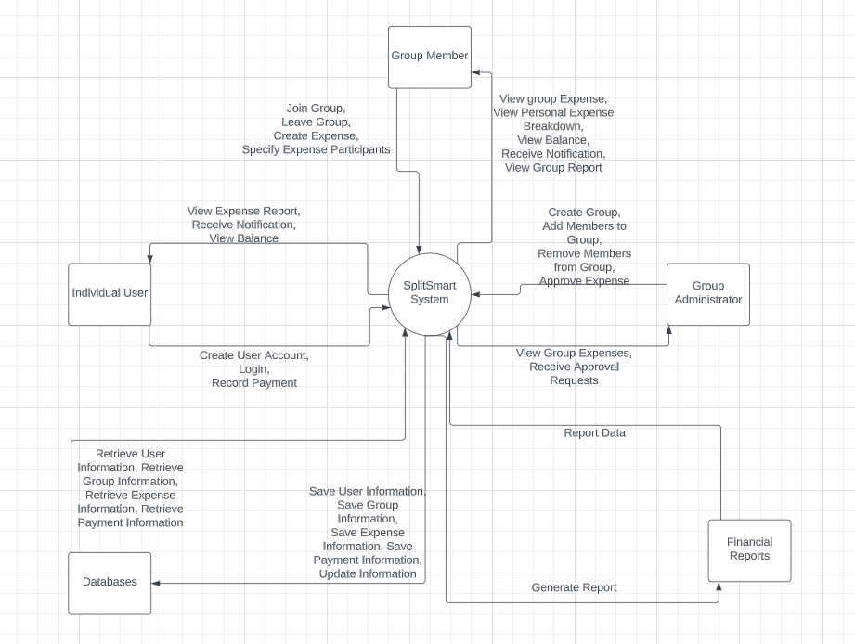
Context Diagram

Slide 19
Conclusion

